Slide 1
2016 Annual Report

Slide 2
MISSION
The Professionals of the Owensboro Fire Department are dedicated to providing a high level of safety and emergency services protecting the lives and livelihoods of the Citizens and Visitors of the Owensboro Community
Core Values
Compassion
Caring
Concern
Respect
Trust
Excellence
Teamwork
Integrity
Saving Lives…………………………Protecting Property
Since 1866

Slide 3
Fire Chief
Admin Support
Emergency Services
Special Operations
Fire Prevention and Community Services
Human Resource Development
EMS
Emergency Planning and Special Events
Public Risk Reduction
Insurance Rating = Class 2

Slide 4
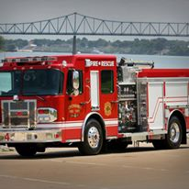
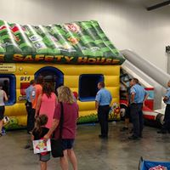
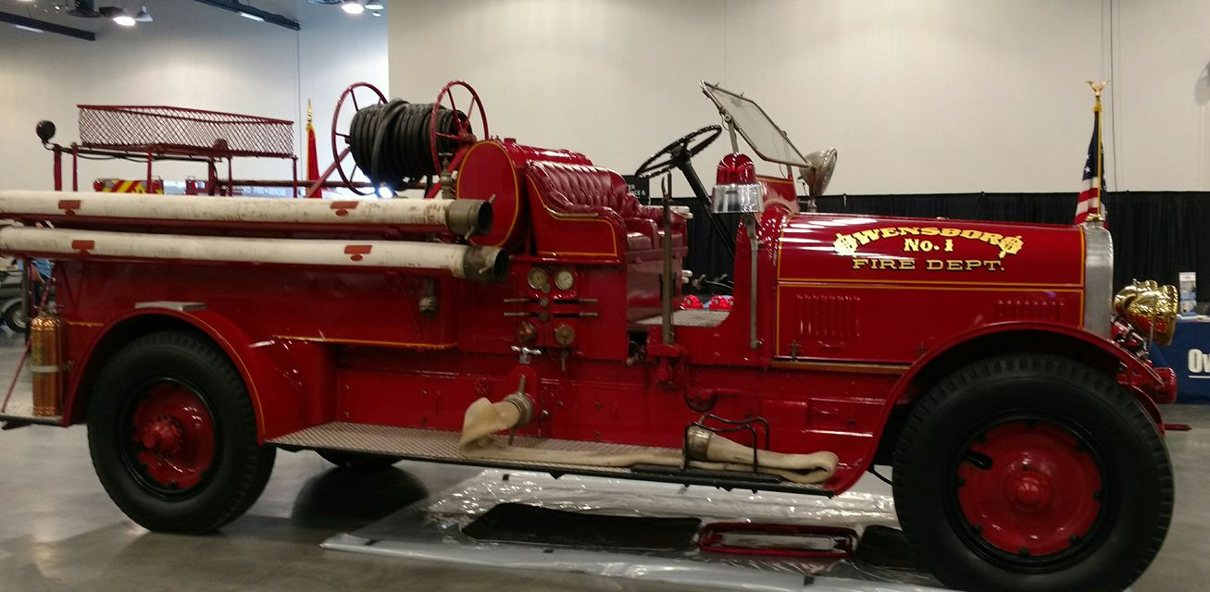
The Owensboro Fire Department celebrated 150 years of service to the Citizens of Owensboro in 2016. OFD had several events throughout the year, including a birthday party for the public in August.

Slide 5
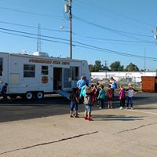
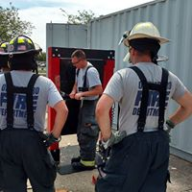
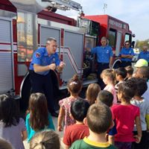
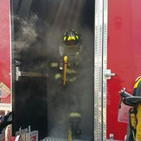
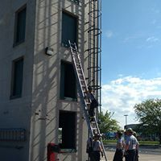
GOALS
The Owensboro Fire Department established a Vision 2020 document in 2015 that sets forth goals and objectives toward the primary overall strategy to maintain a high quality level of emergency and risk reduction service for the Owensboro Community in a fiscally responsible manner.

Slide 6
2016 – 2017 Budget
Personnel Services - $8,044,777
Maintenance - $328,280
Supplies - $281,622
Utilities - $267,870
Other - $137,268
Capital - $537,723
Total = $9,597,540

Slide 7
OFD responded to 153 different incident types in 2016
Total Apparatus Responses – 11348
Total Emergency Responses Presented Above – 7706
In 2016 25% of incidents overlapped

Slide 8
2016 Incidents

Slide 9
2016 Incidents

Slide 11
Leading Fire Incident Calls For Service Cause: Cooking
2016 – 111
2015 – 185
2016 Civilian Fire Related Deaths
ZERO
OFD, along with local partners such as the Red Cross and Neighborhood Alliances, provided fire safety information for over 1500 homes and installed over 100 smoke alarms.

Slide 12
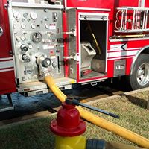
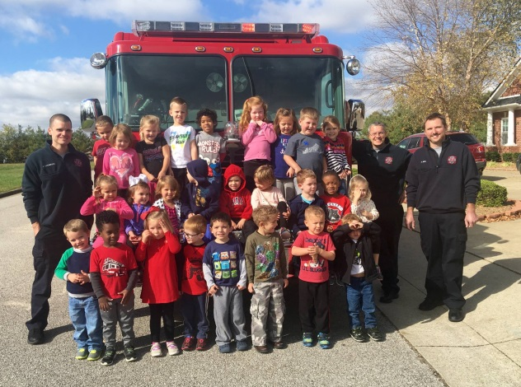
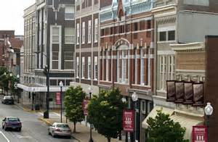
Risk Reduction Activities
Hydrant Flow Testing - 659
Facility Fire and Life Safety Inspections - 1986
Result -In 2016 out of nearly 400 fires only 15 occurred in commercial occupancies
Public Fire Safety Education - 260
Pre-Planning Facility Visits - 180

Slide 13
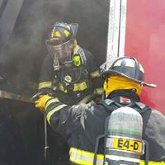
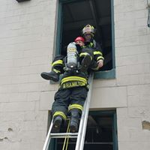
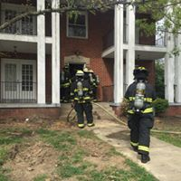
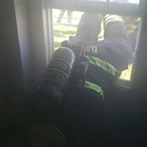
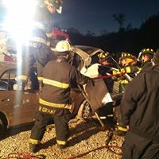
TRAINING
With a total of 16,904 personnel training hours in 2016, OFD completed goals on several training initiatives. This included a comprehensive training program on modern research on fire attack methods and safety, as well as increasing personnel with advanced training in technical rescue techniques.

Slide 14
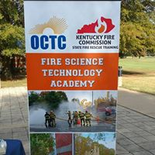
RECRUITMENT
In 2016 the Owensboro Fire Department joined with several partners to announce a new education program that would allow High School Seniors in four counties to enter a Fire Rescue Training Program with credit through the Owensboro Community and Technical College

Slide 15
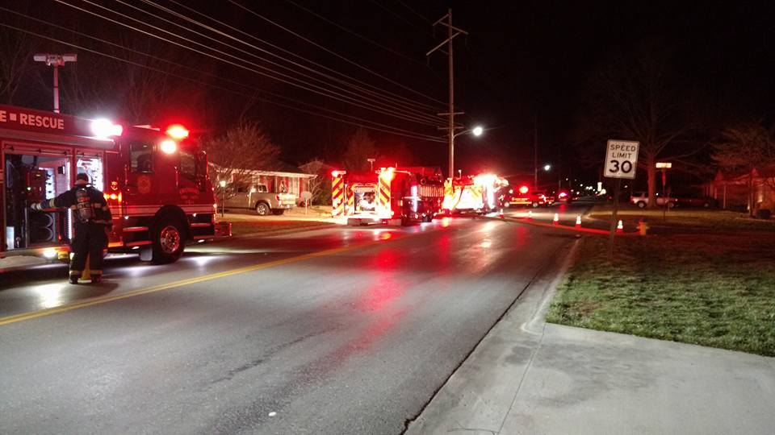
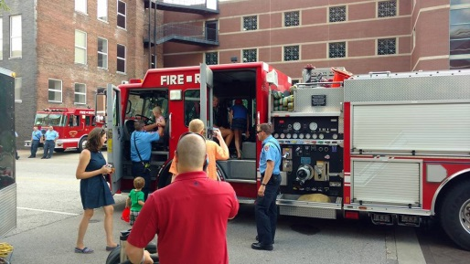
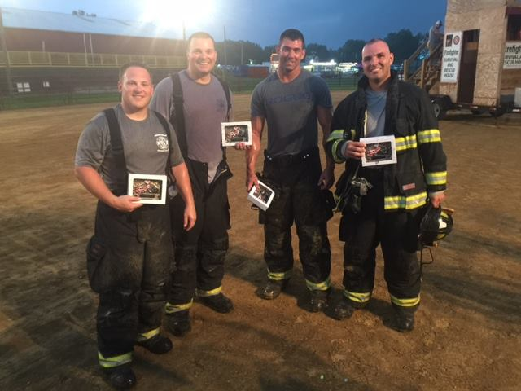
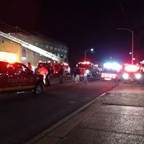
Follow Us…
www.owensborofire.org
www.owensboro.org
Facebook: Owensboro Fire Department

