Slide 1
Owensboro Fire Department
Annual Report 2023
Chief James Howard

Slide 2
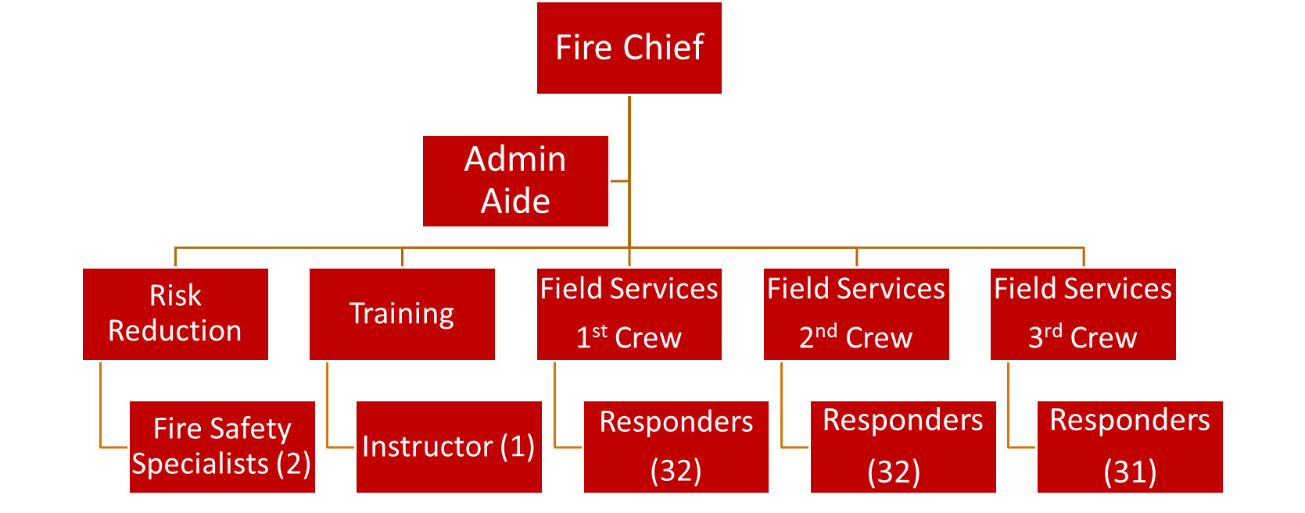

Slide 3
2023-2024 Fiscal Year Budget
Personnel - $13,244,380
Training - $72,660
Maintenance - $464,417
Supplies - $185,215
Utilities - $262,842
Capital - $997,286
Other - $468,438
Total - $15,695,238

Slide 4
2023 Emergency Activity Statistics
372 Fires
31 Structure Fires
26 Cooking Fires
32 Vehicle Fires
3,811 EMS/Rescues
305 Respiratory
129 Traumatic Injury
615 Cardiac
5,712 Calls for Service

Slide 5
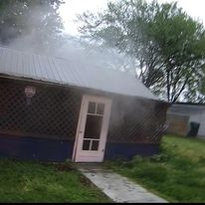
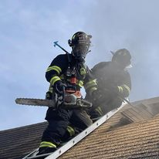
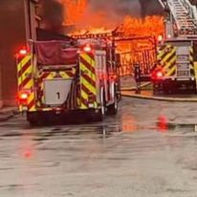
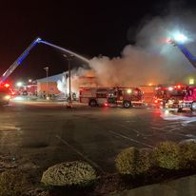
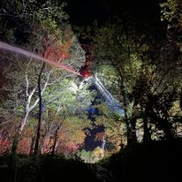
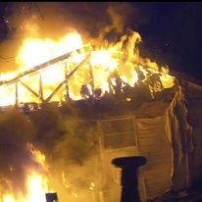
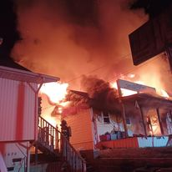
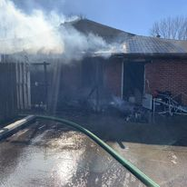
2023 Fire Response Year in Review

Slide 7
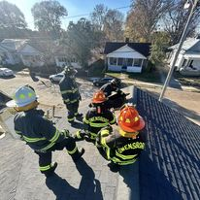
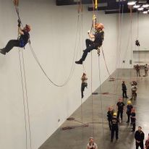
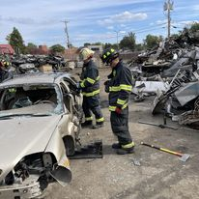
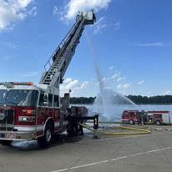
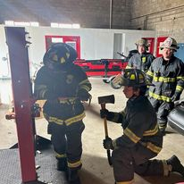
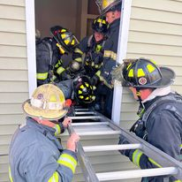
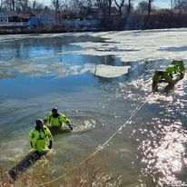
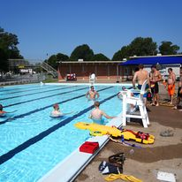
2023 Training Year in Review

Slide 8
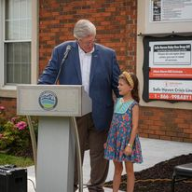
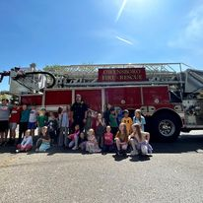
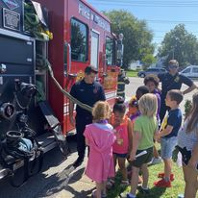
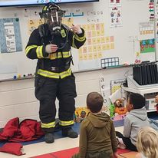
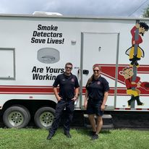
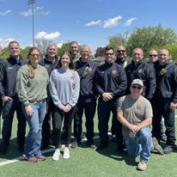
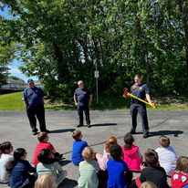
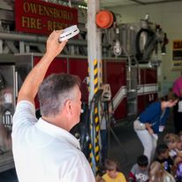
2023 Prevention and Public Relations Year in Review

Slide 9
2023 Non-Emergency Activity Statistics
14,970 Individual Training Hours
978 Fire and Life Safety Inspections
37 Public Education Events

Slide 10
2023 Promotions
Corey Gant—Battalion Chief (Training)
Bobby Grant—Battalion Chief (1st Crew)
Luke Cecil—Captain (3rd Crew)
Brian Roberts—Captain (2nd Crew)
Clayton Tuma—Captain (1st Crew)
Ted Johnston—Lieutenant (Training)
Brannon Pendergraft—Lieutenant (2nd Crew)
Easton Weathers—Lieutenant (3rd Crew)
Kevin Klobe—Engineer (1st Crew)
Jared Peacock—Engineer (1st Crew)
Josh Sexton—Engineer (3rd Crew)

Slide 11
2023 Awards
Nominations and votes for these awards are made by the members of the Owensboro Fire Department to shine a light on those who provide the best example among ranks:
Rookie of the Year—Justin Wheeler
Firefighter of the Year—Doug Roth
EMS Responder of the Year—Colby Smith
Engineer of the Year—Steve Zoglmann
Officer of the Year—Joey Wright

Slide 12
2023 Goals Accomplished
Achieved efficiency in call response volume with continued changes to dispatch protocol
Completed multi-year plan to equip department for Swiftwater Rescue response
Partnered with Red Cross for Smoke Detector blitz
Improved outreach and public engagement through social media
Installed Safe Haven Baby Box at Station 1

Slide 13
2024 Goals
Enhance Advanced Life Support program with addition of paramedic at Station 5
Achieve CFAI accreditation
Complete the construction of Fire Training Center
Equip fire stations for cancer prevention
Equip department to fight EV fires
Participate in Firefighter Training Exchange with Olomouc

Slide 14
Owensboro Fire Department
Please visit us on FaceBook
and be safe

